Slide 1

Computational Methods in
Power System Analysis
Lecture-9 Fault Analysis in Power System
By
Dr. Wazir Muhammad Laghari
Electrical Engineering Department
BUET, Khuzdar

Slide 2
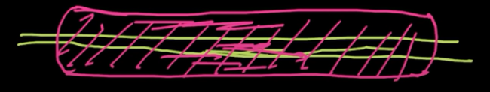
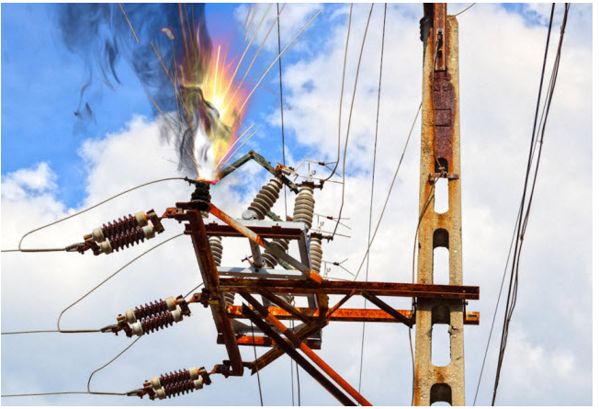
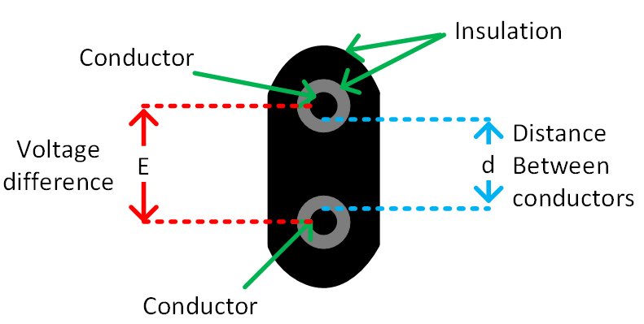
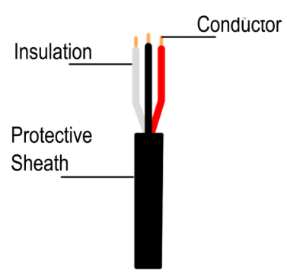
Fault
Failure of Insulation is called Fault. OR
In an electric power system, a fault or fault current is nothing but a any abnormal electric current flow in the circuit.
A current carrying wire and protect it to cover, if failure of covering than high voltage touch with any iron table or etc means low voltage.
Material between HV and LV parts to avoid unexpected flow of current is called Insulation.

Slide 3
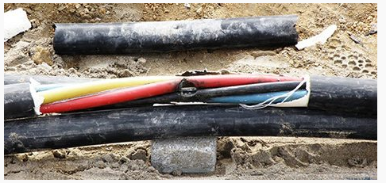
1) Underground Cable
Underground Cable
Transformer Failures
Lightning
Tree Contact
Birds
Squirrels
Snakes
Insects

Slide 4
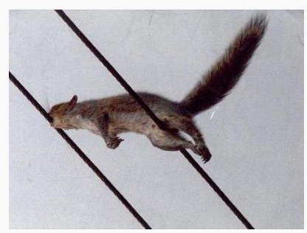
6. Squirrels
Squirrels are a reliability concern for all overhead distribution systems near wooded areas. Squirrels will not typically climb utility poles, but will leap onto them from nearby trees.
A squirrel chewed into a power line in Trumbull, Connecticut, where the Nasdaq’s computer center is located, shutting down trading for 34 minutes. It was the second time it had happened.
They cause faults by bridging grounded equipment with phase conductors. Squirrel problems can be mitigated by cutting down nearby access trees or by installing animal guards on insulators.

Slide 5
Snakes
Snakes are major reliability concerns in both substations and underground systems. They can squeeze through very small openings, can climb almost anything, and have the length to easily span phase conductors.
Snakes are usually searching for food (birds in substations and mice in underground systems), and removing the food supply can often remove the snake problem. Special “snake fences” are also available.

Slide 6
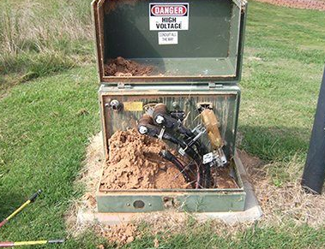
8. Insects
It is becoming more common for fire ants to build nests in pad mounted equipment.
Their nesting materials can cause short circuits, the ants can eat away at conductor insulation, and they make equipment maintenance a challenge.

Slide 7
9. Bears, Bison, and Cattle
These large animals do not typically cause short circuits, but degrade the structural integrity of poles by rubbing on guy wires. Bears can also destroy wooden poles by using them as scratching posts, and black bears can climb wooden utility poles. These problems can be addressed by placing fences around poles.

Slide 8
10. Mice, Rats, and Gophers
These rodents cause faults by gnawing through the insulation of underground cable. They are the most common cause of animal-related outages on underground equipment. To make matters worse, they will attract snakes (also a reliability problem).
Equipment cabinets should be tightly sealed to prevent these small animals from entering.

Slide 9
11. Vandalism
Vandalism can take many different forms, from people shooting insulators with rifles to professional thieves stealing conductor wire for scrap metal. Addressing these reliability problems will vary greatly from situation to situation.

Slide 10
Transformer Failures
When a transformer becomes hot, the insulation on the windings slowly breaks down and becomes brittle over time.

Slide 11
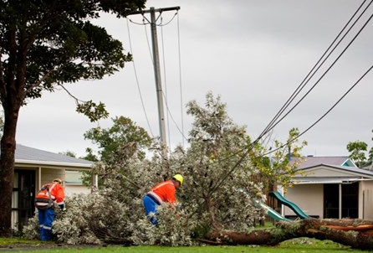
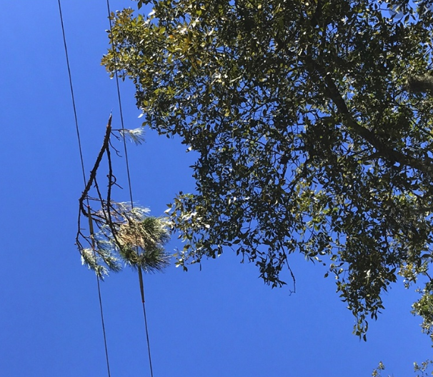
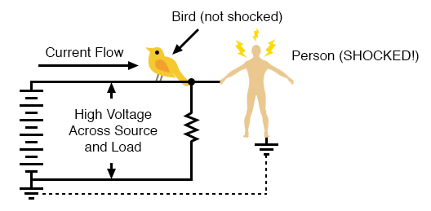
Tree Contact
Trees continuously grow, can fall over onto conductors, can drop branches onto conductors, can push conductors together, and can serve as gateway for animals. This is why many utilities spend more on tree trimming than on any other preventative maintenance activity.

Slide 12
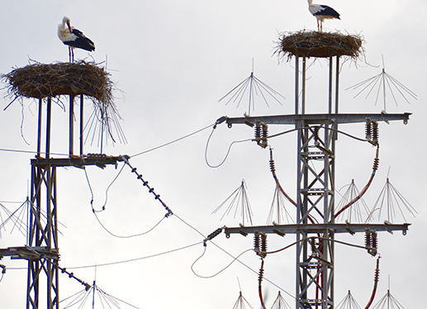
Birds are the most common cause of animal faults on both transmission systems and air insulated substations.
Different types of birds cause different types of problems, but they can generally be classified as nesting birds, roosting birds, raptors, and woodpeckers.

Slide 13
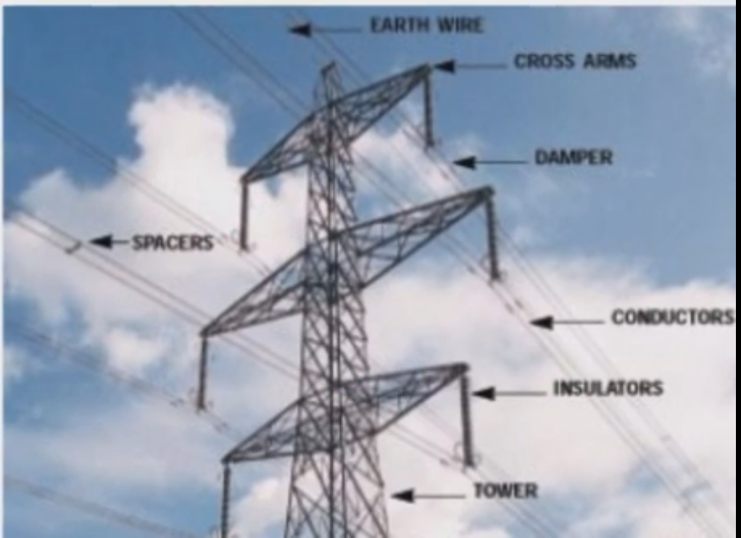

Slide 14
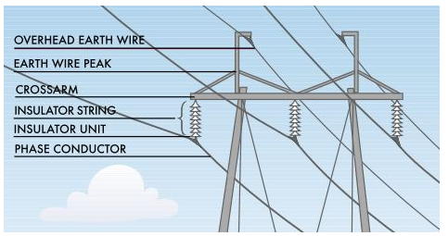

Slide 15
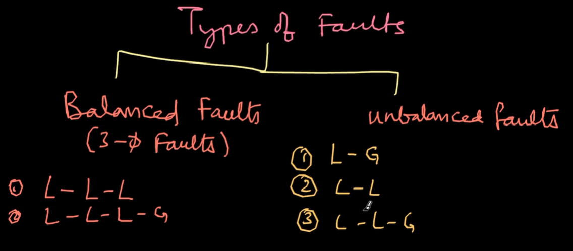

Slide 16
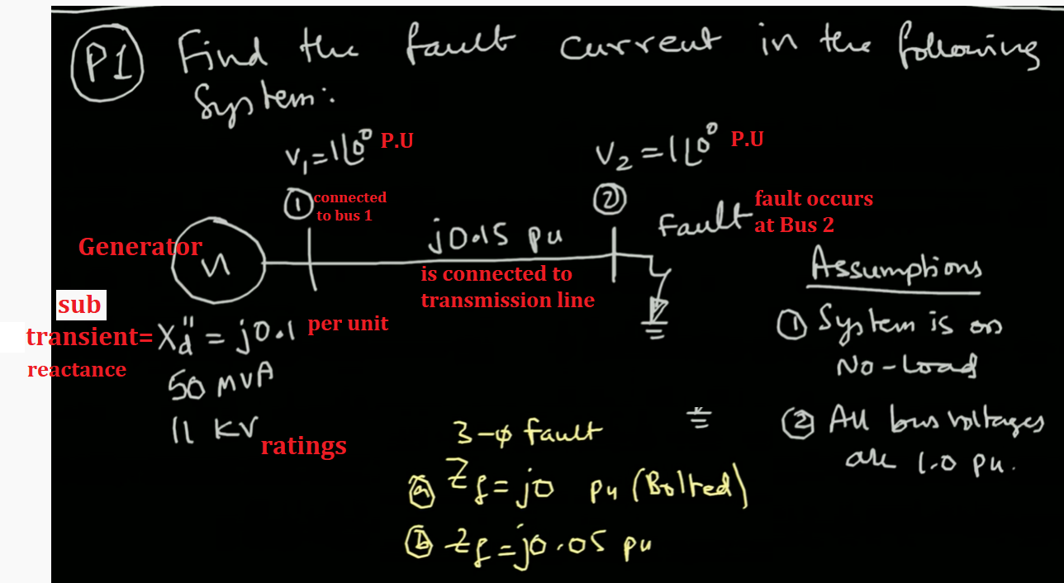

Slide 17
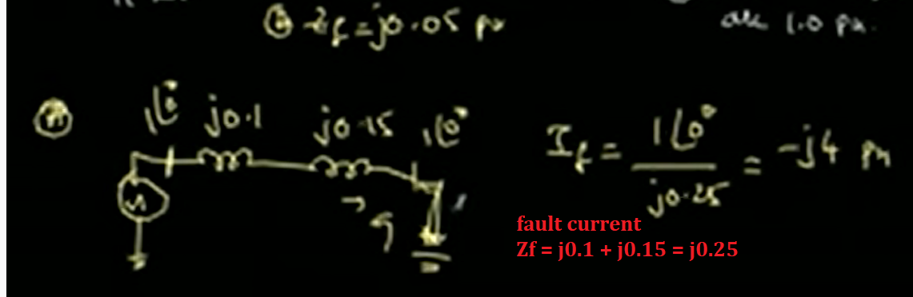
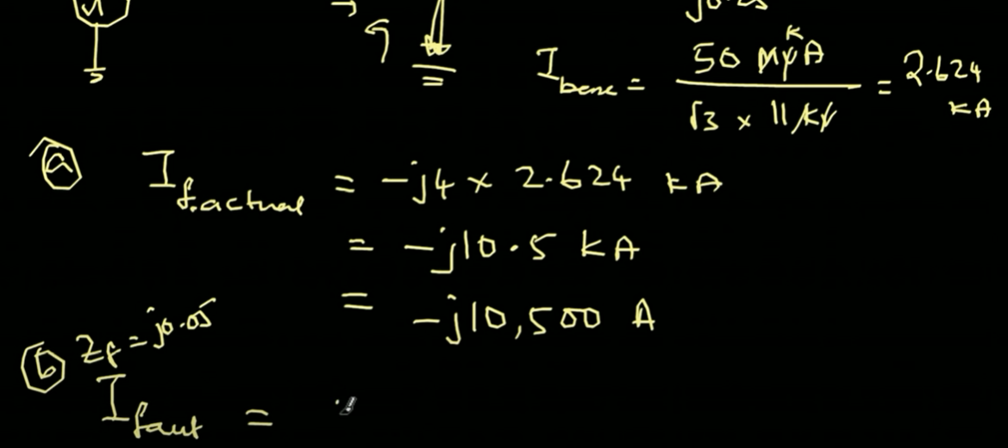

Slide 18
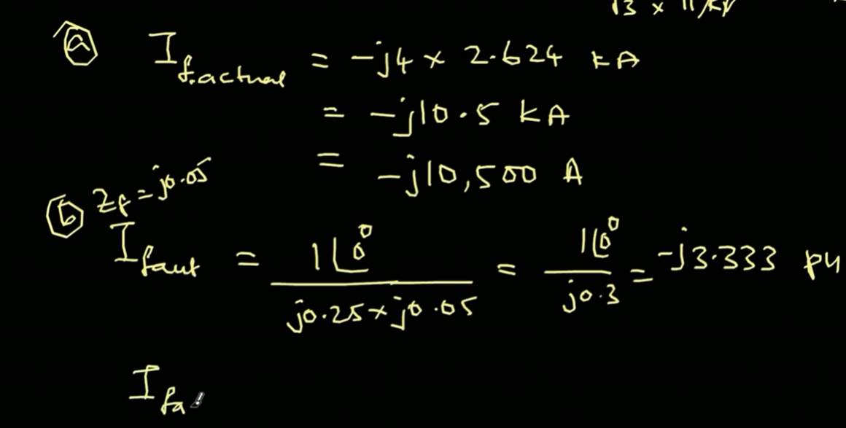
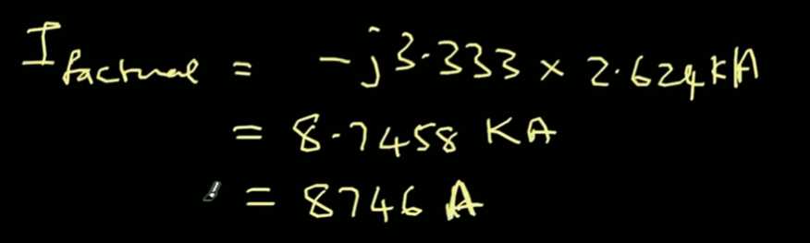

Slide 19
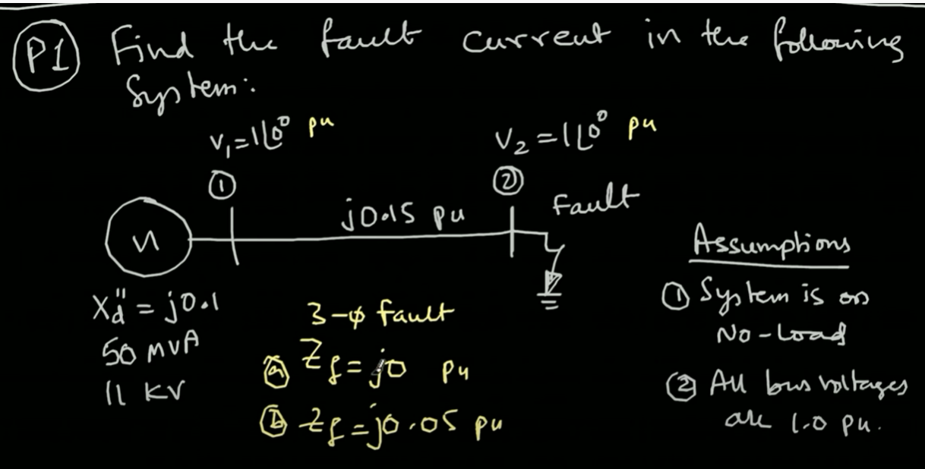
Q1: Find the Fault current in the following system:

Slide 20
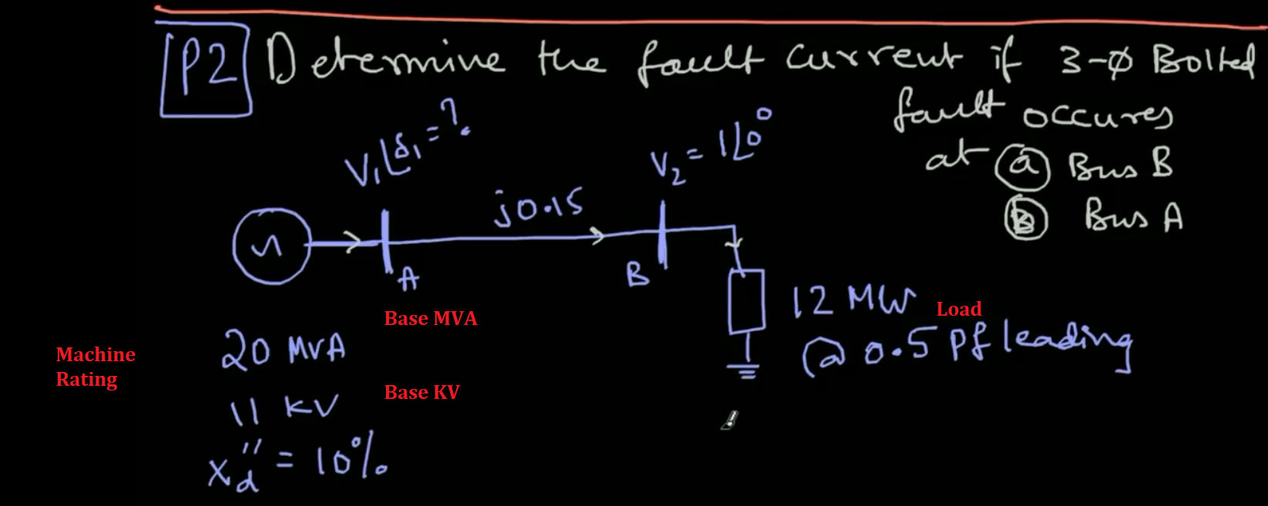
Normal Operation and current flow

Slide 21
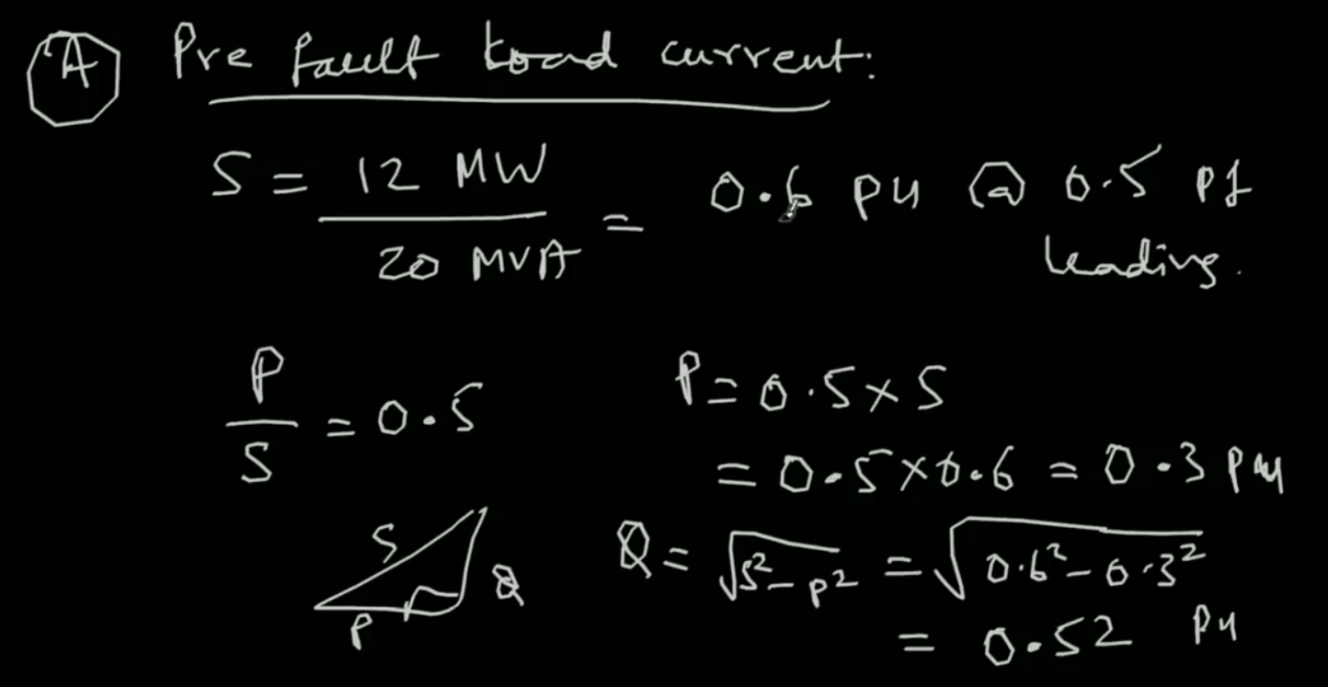

Slide 22
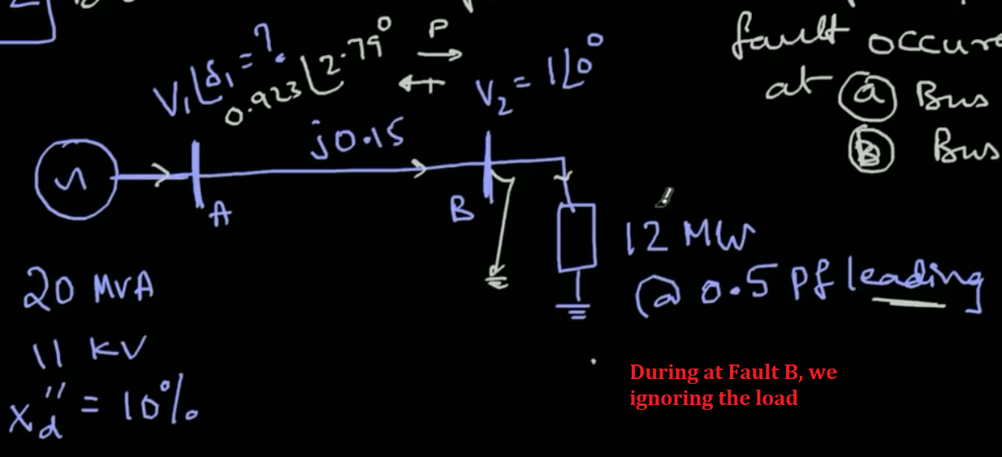

Slide 23
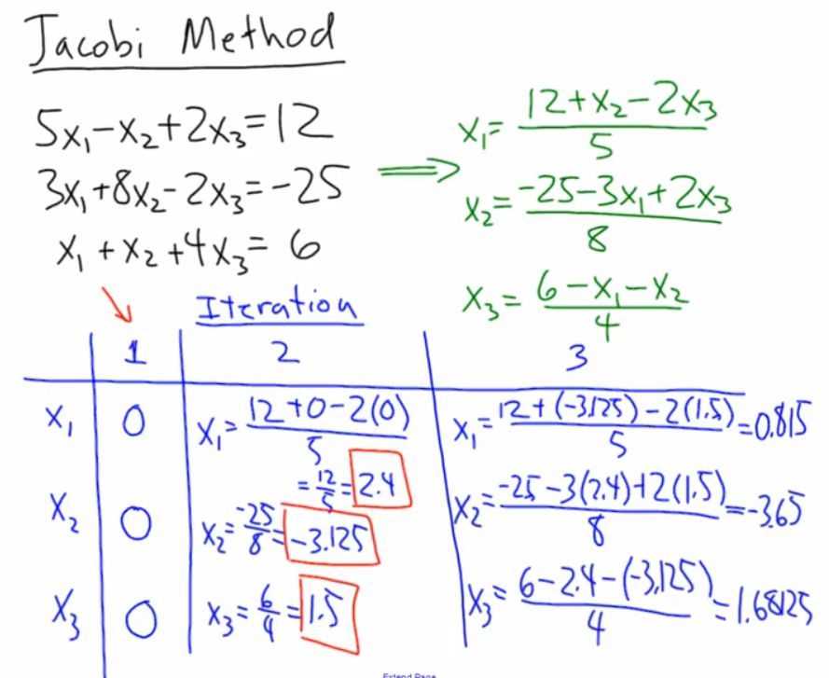

Slide 24
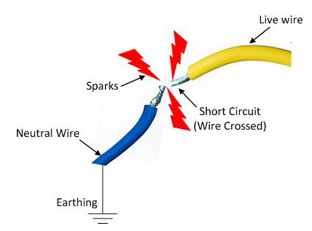
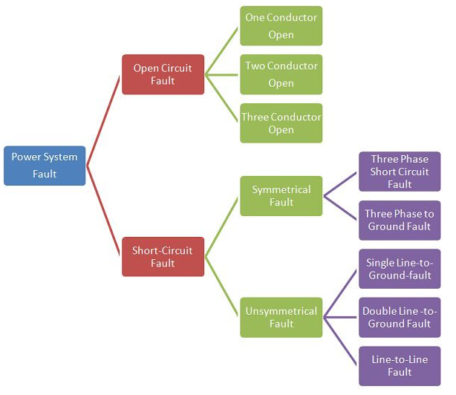
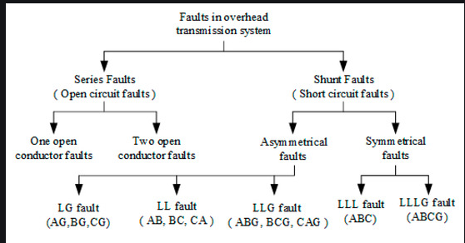
TYPES OF FAULTS IN POWER SYSTEM

Slide 25
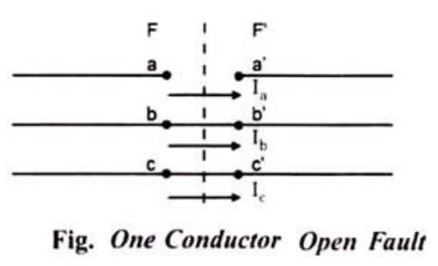
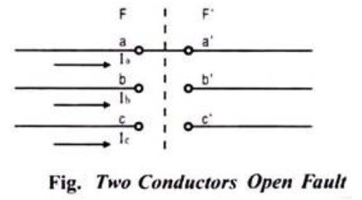
Open Circuit Faults OR Series Faults
The open circuit fault mainly occurs because of the failure of one or two conductors. The open circuit fault takes place in series with the line, and because of this, it is also called the series fault. Such types of faults affect the reliability of the system.
Types Of Open Circuit Faults OR Series Faults
Open Conductor Fault.
Two conductors Open Fault.
Three conductors Open Fault.

Slide 26
Open conductor faults are series faults which involve a break in one or two of the three conductors of a three phase power system. As such, the fault is an unsymmetrical fault and thus, the theory of symmetrical components was revisited.

Slide 27
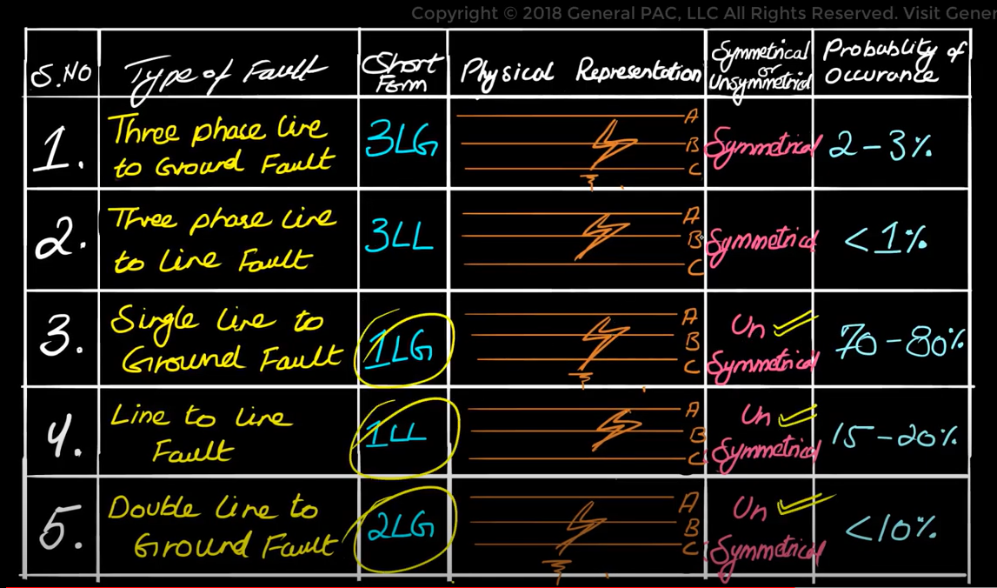
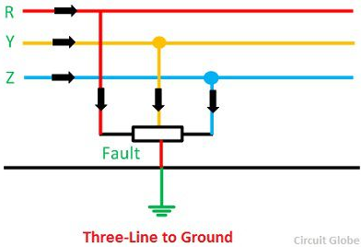
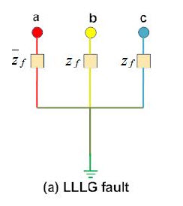
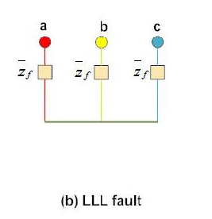
Three phase line to ground Fault, where A , B, C are shorted together and they are
Grounded.
These two faults 3LG and 3 LL faults are quiet similar to each other
In this type of fault A,B,C that are shorted together but ground is not involved.

Slide 28
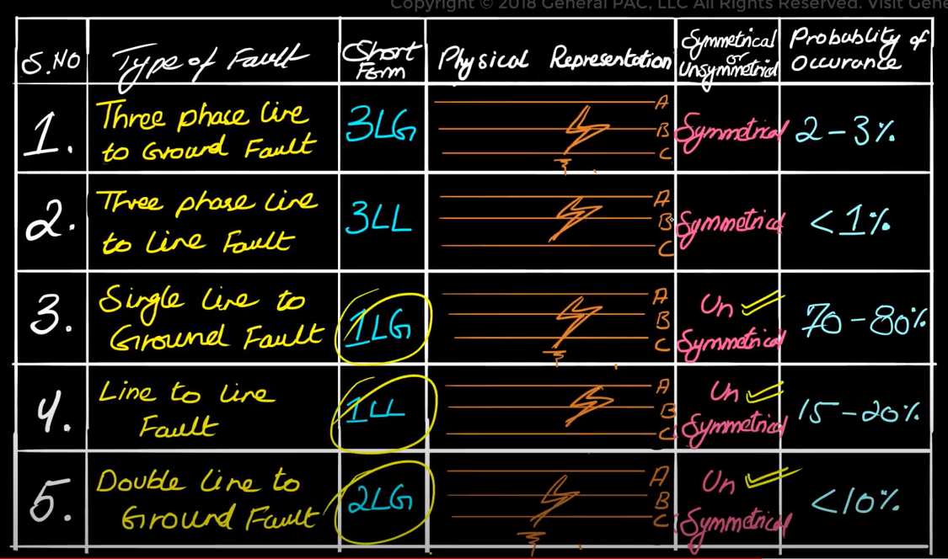
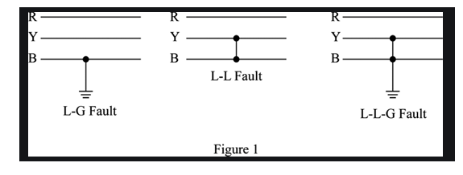
A system in which you have a single to ground fault occurs when phase A is shorted with ground, or phase B shorted with ground or phase C is shorted with ground
And the reason why imagine you have know three phases on a pole that stretches for a mile and on both sides of that pole you might have trees or even on one side of that pole you may have trees limbs (branches of trees) or other animals that are around it so if a tree branch actually brushes up against that line that will produce a line to ground fault or if an animal gets on top of the line and it accidentally touches the line and the ground at the same time it will also produce Line to ground fault or even a bird so this type of faults commonly occur in power system

Slide 29
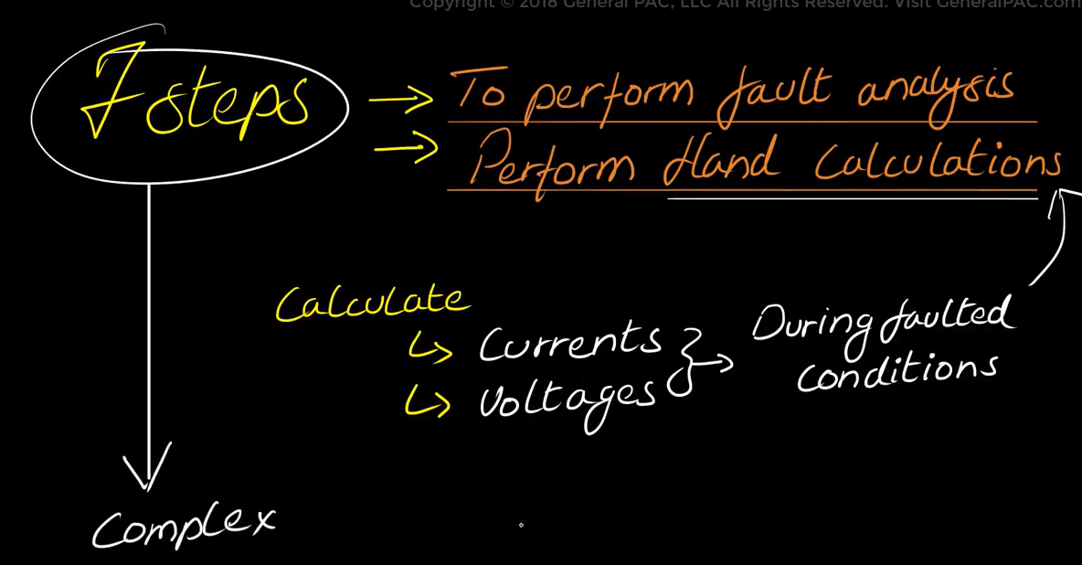
Line to Line Fault
This type of fault occur in between the Line A and Line B or Line B and C short together.
Double Line to Ground Fault involves two lines with ground like A and B with ground or B and C with ground

Slide 30
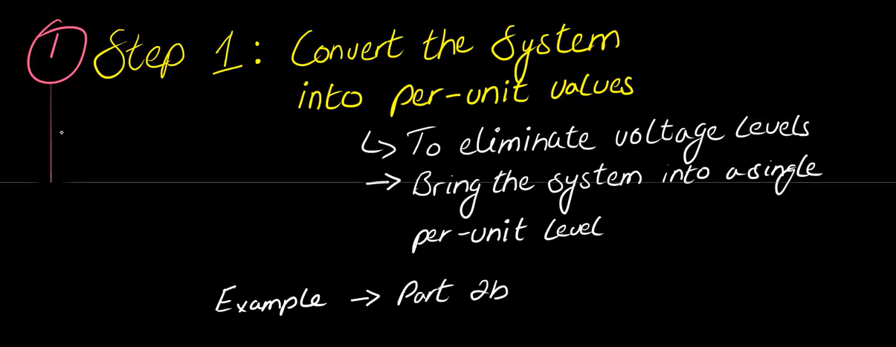
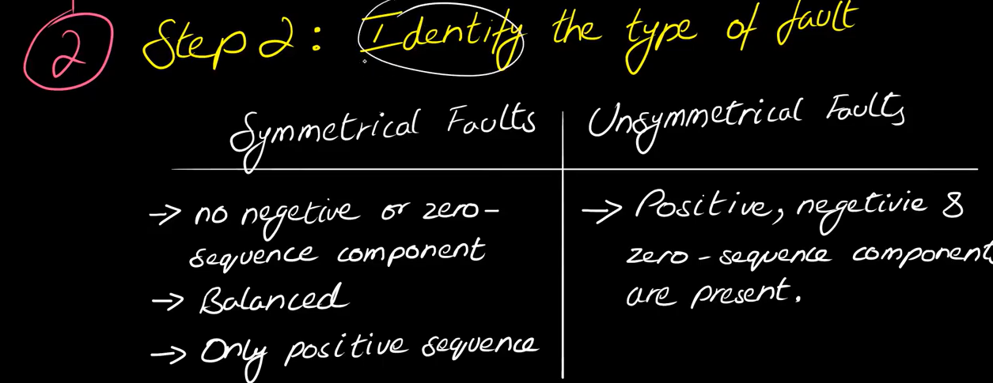

Slide 31
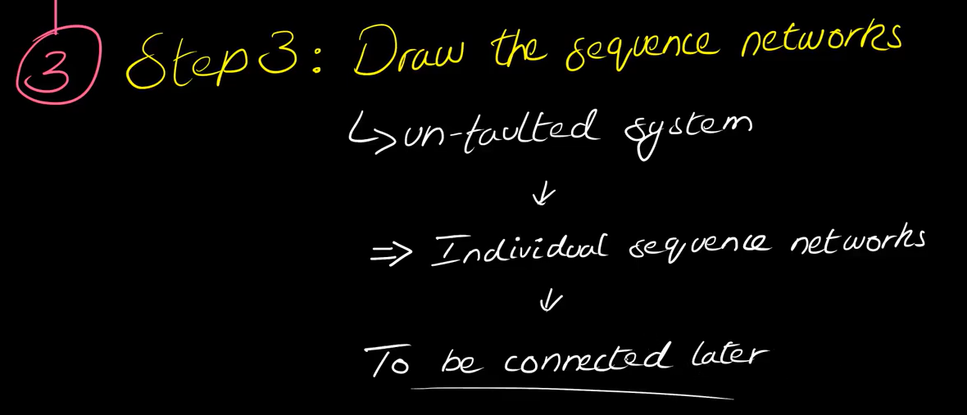

Slide 32
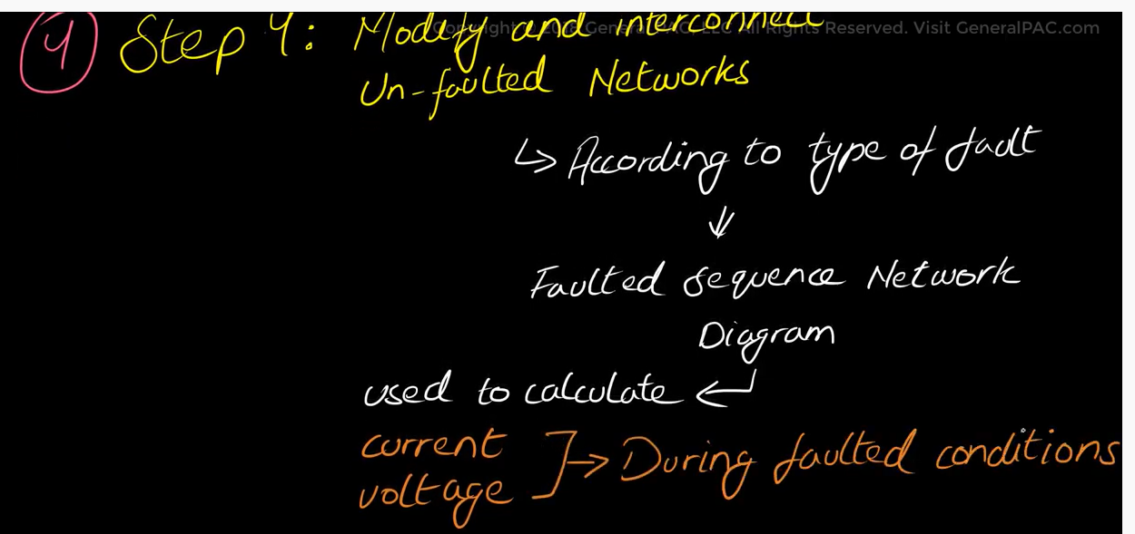

Slide 33
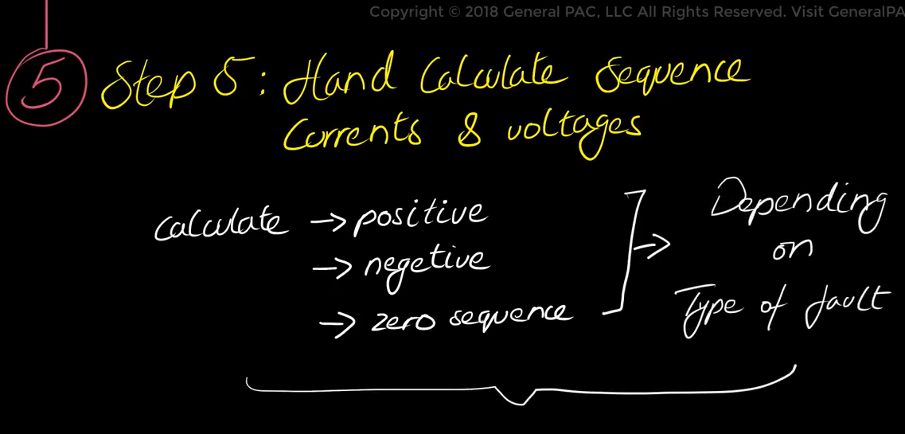

Slide 34
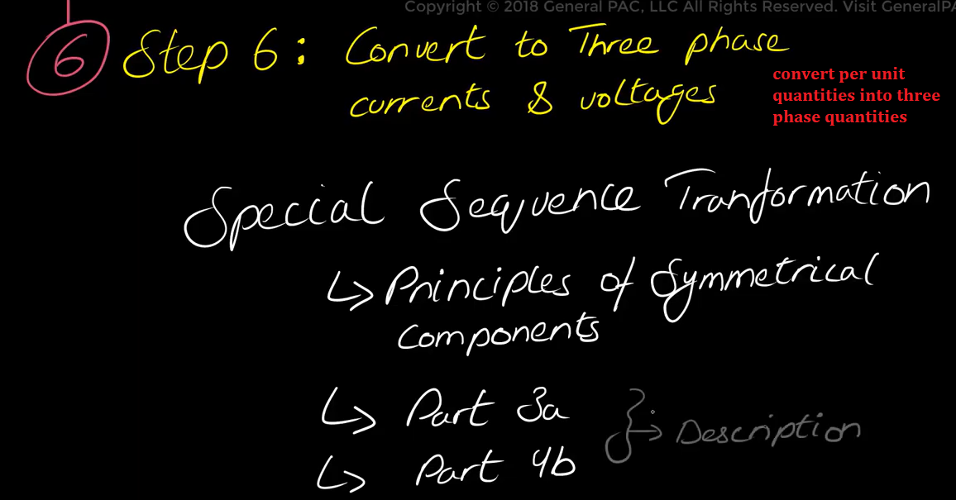

Slide 35
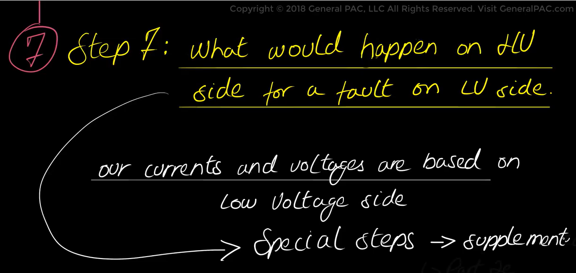

Slide 36


Slide 37


Slide 38
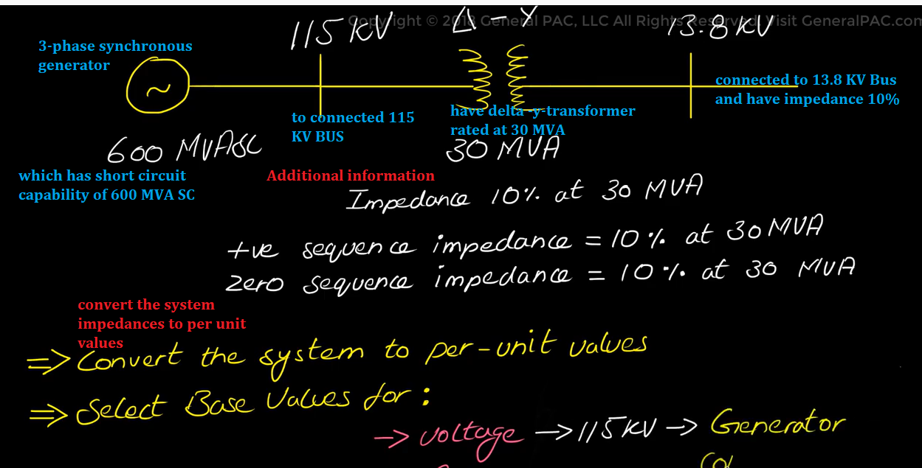

Slide 39
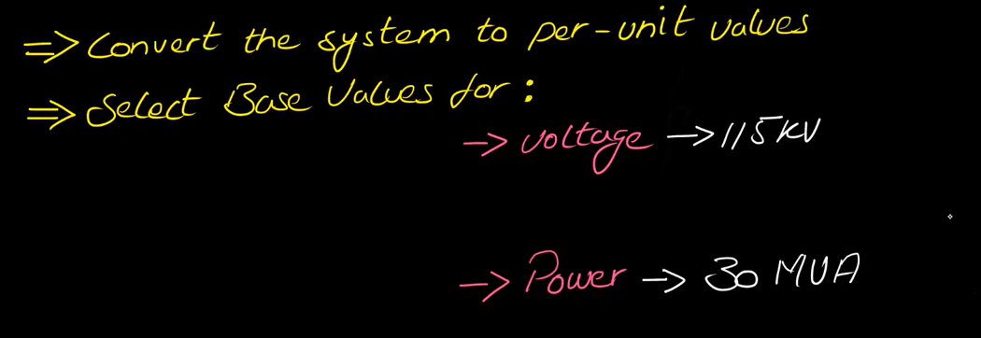
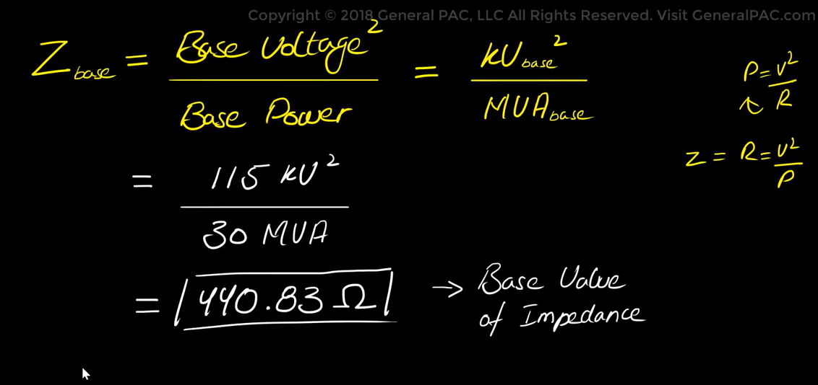

Slide 40
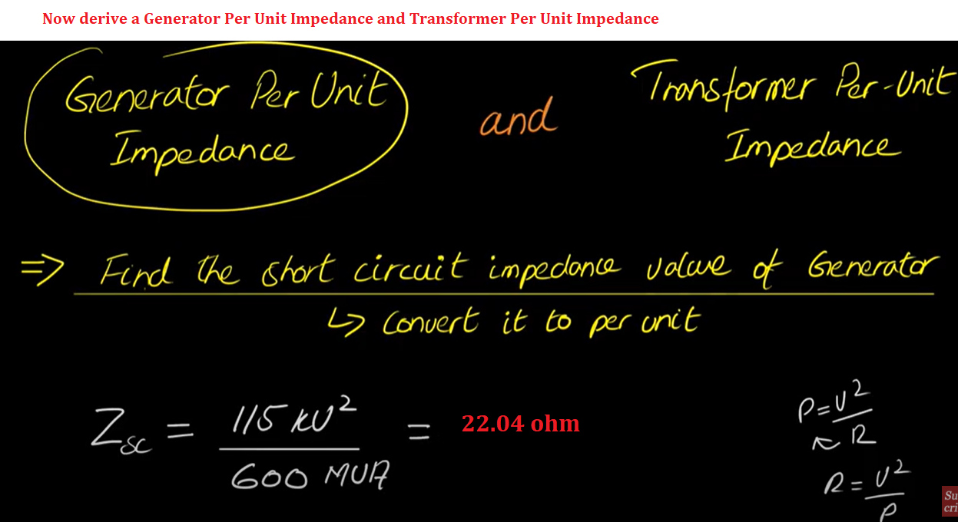

Slide 41
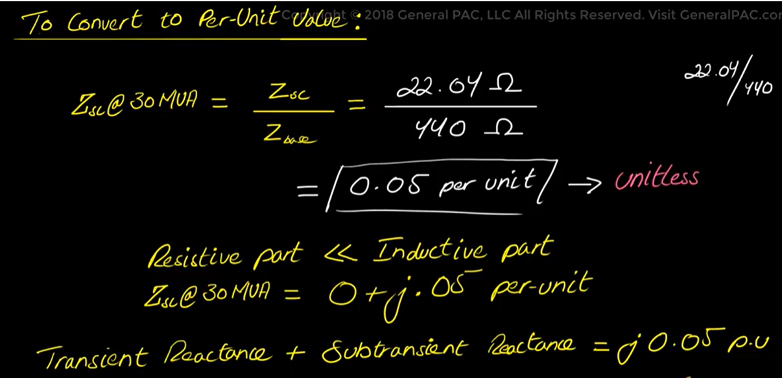

Slide 42
